Slide 1

ORGANIZED SECTION OFFICER ORIENTATION
Presenters:
Kim Mealy, Executive Director
Casey Harrigan, Director, Member Services
Jon Gurstelle, Sr. Director, Publishing
Clarissa Westphal Nogueira, Manager, Communications & Web Development
Steve Stoupa, Director, Finance & Administration

Slide 2


Webinar Logistics
If you have any questions during the presentation please use the raise hand function or submit them in the Q&A option on your screen.
This webinar is being recorded and will be made available on the APSA website.

Slide 3
Agenda
Welcome and Purpose of Webinar
APSA Staff
Current Section data and trends
Annual Meeting overview
Important Dates
Rosters
APSA Connect
APSA Website and Section Microsites
Journals
Finances
Questions

Slide 4
Introduction
There are currently 53 APSA Organized Sections.
Sections are a critical part of APSA and the APSA staff are committed to supporting the growth and development of the sections.
Section membership can be added at the time of renewal or anytime throughout your membership.

Slide 5
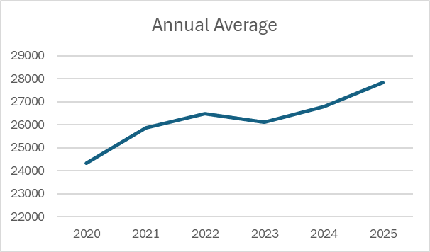
Organized Section Membership
Organized Section Membership as of 10/31/2025: 26,990
Overall APSA Membership as of 10/31/2025: 10,274

Slide 6
Current Organized Section Overview
The average section membership is 481 members.
Professional Dues:
Average - $10
Range from $5 - $35
Student Dues:
Average - $0
Range from $0 - $25
43 sections now have waived dues for student members.
64% of APSA members belong to one or more organized section.
60% of Regular Members are a member of 1 or more section, belonging to 3 sections on average.
67% of Student Members are a member of 1 or more section, belonging to 6 sections on average.

Slide 7

2026 Virtual Research Meeting
Two-day virtual event, April 2026 – final date TBD
Scholars share their research, provide constructive feedback, and build networks and partnerships
Innovative Research Workshops, general panels, and virtual keynote or plenary sessions

Slide 8
Panel Allocations
Panel slot numbers will be on par with Vancouver, which is above previous years
Divisions receive 80% of panel allocations
Both in-person and virtual panel attendance numbers from 2025 will be used to calculate 2026 allocations
Full paper panels can have up to five papers

Slide 9
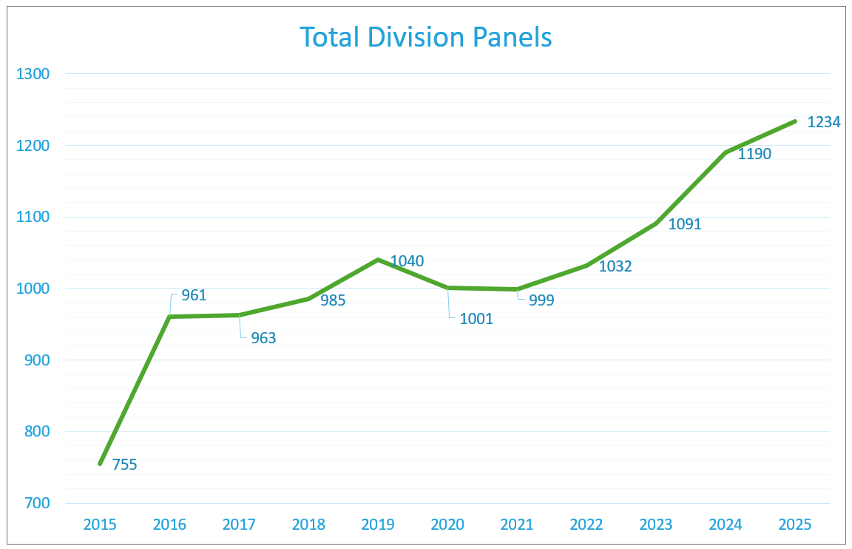

Slide 10
2025 Organized Section Awards
266 total awards
Awards carrying a monetary value range from $100 - $1500 and/or a travel grant to attend the Annual Meeting.
Number of awards presented by each section range from 1-10.
5 awards are presented on average by each section.

Slide 11
2026 Organized Section Awards
All information that has been received to date has been posted to each section’s webpage
Recommended nomination deadline: March 1, 2026
Recipient information due to APSA: June 1, 2026
Available resources:
The Organized Section Award Best Practices Guide
Awards certificate template
Awards promotion

Slide 12

Section Support Grants
Provide monetary support to members leading up to the 2026 Annual Meeting
APSA assists sections with collecting applications for grants. Once applications are collected, sections have access to approve or decline applications.
Support Grant funds come directly from Section General Account
Interest form will be circulated in May
Previous totals:
2022 – 8 Sections provided 49 grants totaling $16,620
2023 – 6 sections provided 38 grants totaling $11,600
2024 – 10 sections provided 60 grants totaling $25,000 2025- 15 sections provided 87 grants totaling $35,000

Slide 13
2025-26 Important Dates
December 2025 Affiliated event request application opens
January 14, 2026 2026 Call for proposals closes - Including Short Courses
January 22, 2026 Panel allocations emailed to divisions; Division chairs given access to system for proposal review and panel construction
February 27, 2026 Panel Construction Deadline
March 31, 2026 Affiliated Event Request Application Closes
June 1, 2026 Award Recipient Information due to Member Services Offsite reception contracts due to APSA for review and signature
September 3-6, 2026 122nd APSA Annual Meeting – Boston, MA

Slide 14

“For Section Officers and Organizers” Webpage
Located under membership > Organized Sections > For Section Officers and Organizers
https://apsanet.org/membership/organized-sections/for-section-officers-and-organizers/
APSA Website
Organized Section Handbook
Orientation Manual and webinar
Elections Best Practices Guide
Marketing Toolkit
Award Certificate Template
APSA Connect Guides
Up to date member roster
Payment Request Forms*
Via APSA Staff
Lapsed section member lists
Historical section information
Officers
Membership totals
Finances
Election ballot assistance
Event promotion
Establishing a new microsite
Submit a section highlight for the APSA all-member newsletter

Slide 15
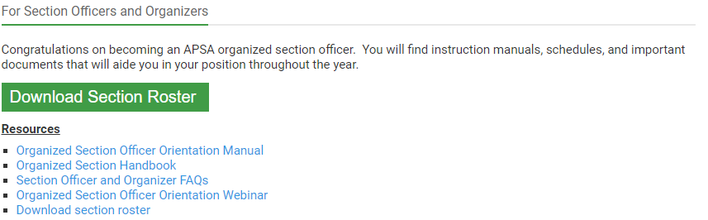
Section Rosters
Section Chairs, Treasurers, and Secretaries have access to download current member rosters, once logged in to their APSA account, through the “For Section Officers and Organizers” page.
Section rosters include whether the member is a Student Member or a Regular Member.

Slide 16
Member Lists
APSA member lists available upon request:
Lapsed section member lists
Current APSA members based on fields of interest
Member lists should only be used to facilitate communication with section members for section related announcements only. Member lists should not be shared, sold, or traded.
Journal membership roster requests should come to the membership department who will send the roster directly to the journal publishers.

Slide 17
New Section Proposal 30-day Comment Period
In 2022 APSA Council approved updates to the Organized Section Handbook regarding the creation of new sections.
Organizers of potential new organized sections are encouraged to reach out to Chairs of pre-existing sections to request statements of support for inclusion in their proposal.
Once a proposal for a new section is received, the proposal will be circulated to pre-existing Chairs for a 30-day open comment period. If you have any concerns about the creation of the new section please be sure to respond within the time period.

Slide 18
APSA Website
Each section has its own landing page on https://apsanet.org/membership/organized-sections/ that provides general information about each section including:
Current Officers
Section dues
Award committees and nomination deadlines
Previous award recipients
All pages are currently being updated with the 2025-2026 information that has been received.
Update requests can be sent to membership@apsanet.org

Slide 19
APSA Connect
Log in at connect.apsanet.org. Each organized section has a community, forum and document library.
Improved APSA Connect platform that allows section officers and members connect with each other, share resources and information, and network with colleagues through discussion forums, document library, and directory
Section chairs, including some section officers, are allowed administrative access to edit, manage and/or update information listed on their section groups, forums, and microsite.
Questions about access and privileges should be directed to APSA Communications communications@apsanet.org
Instructions on how to navigate your section community including posting messages, uploading documents, editing email settings, and changing your profile image can be found at: connect.apsanet.org/how-to/.

Slide 20
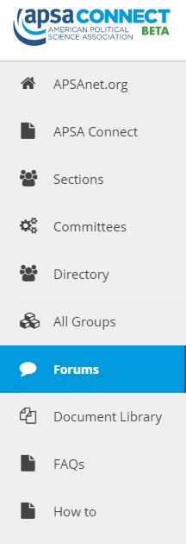
APSA Connect
Discussion Forum
The Discussion forum can be used to post:
Section updates & announcements
Elections
Calls for papers
Job announcements – All job listings must be posted to eJobs prior to being posted to APSA Connect
Meeting notifications

Slide 21


APSA Connect
Document Library
Use the document library to upload documents to make them accessible to your members.
Share announcements
Conference papers
Teaching slides
Access your section library by visiting your section landing page in APSA Connect and selecting “Documents”
The document library can be found here: https://connect.apsanet.org/documents/

Slide 22
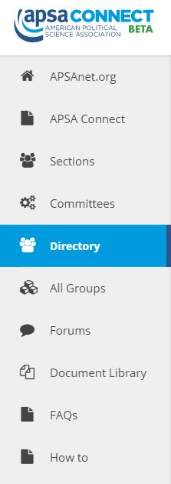
APSA Connect
Directory
You can browse the enhanced search and profile options in the APSA Connect directory.
To change your profile information, login to your MyAPSA profile on apsanet.org.
The directory can be accessed here: https://connect.apsanet.org/members/

Slide 23
Journals
21 organized sections offer a subscription to a journal as a member benefit
Section partnerships range from ownership, editorial control or simply member subscriptions
Jon is a resource for the sections as they contemplate their plans and journal contracts
Issuing RFPs for a new publisher
Contractual negotiations
Best practices in editorial and production.
Journal finance questions
Need Subscription Lists? Contact Member Services at membership@apsanet.org

Slide 24

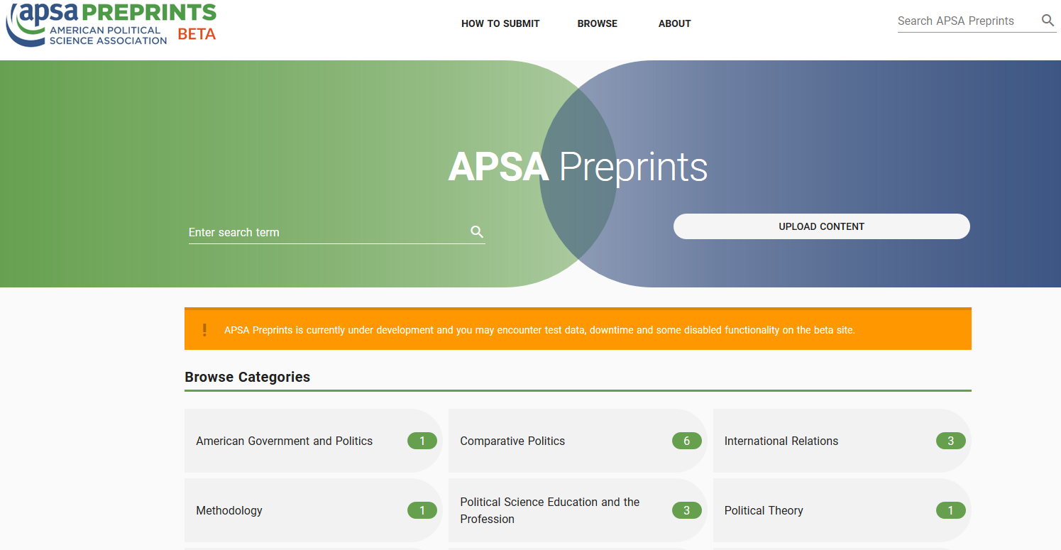
APSA Preprints
Launched at the 2019 Annual Meeting
Home for early research: working papers, conference papers, presentations, data
Subfield classifications and searchability
Posting requires APSA ID (free)
Free to access

Slide 25
Reimbursable Expenses
Organized Sections are encouraged to support their members through awards (book, article, poster, dissertation, career, etc.), travel grants, and research grants.
Additional reimbursable expenses include award plaques, shipping costs, web services, and catering expenses.
APSA is unable to provide reimbursements for Annual Meeting Registrations or APSA Membership/Section dues.
Please contact finance@apsanet.org or membership@apsanet.org if you have any questions about whether an expense is reimbursable.

Slide 26
Finances
Requests for Payment:
Organized Section payment requests are now submitted through APSA’s online application platform.
The link can be found on the Officers and Organizers Webpage and can be accessed using your APSAnet.org log in.
A new link will be posted for CY2026
Requests should be submitted by the Section Chair or Treasurer.
Requests can only be submitted once completed (ACH/International Wire Transfer form, W-9/W-8, Signed Payment Request Form, Supporting Documentation)
For FY2026, award accounts outside of the section’s general account can disburse 4% based on the 12.31.2025 account total.

Slide 27
Finances
Deposits are processed daily
APSA allocates dues to each section on a monthly basis
APSA will distribute reports on a quarterly basis to the section Treasurer.
Year-end reports are provided once the books have been closed for the fiscal year.

Slide 28
Contact Information
Member Services – membership@apsanet.org
Meetings and Events – meeting@apsanet.org
Publications Team – publications@apsanet.org
Communications– communications@apsanet.org
Finance Team – finance@apsanet.org
Teaching & Learning Programs - Teaching@apsanet.org
APSA Educate - Educate@apsanet.org

Slide 29
Questions?

